Slide 1
TRY THIS
Arithmetic operators
The PHP arithmetic operators are used with numeric values to perform common arithmetical operations, such as addition, subtraction, multiplication etc.
Operator Name Example Result
+ Addition $x + $y Sum of $x and $y
- Subtraction $x - $y Difference of $x and $y
* Multiplication $x * $y Product of $x and $y
/ Division $x / $y Quotient of $x and $y
% Modulus $x % $y Remainder of $x divided by $y
** Exponentiation $x ** $y Result of raising $x to the $y'th power

Slide 2
<?php
$x = 8;
$y = 2;
echo $x + $y."\n";
echo $x - $y."\n";
echo $x * $y."\n";
echo $x / $y."\n";
echo $x % $y."\n";
echo $x ** $y."\n";
?>
10 6 16 4 0 64

Slide 3
TRY THIS
Write a program to check the remainder (using Modulus), when ’10’ divided by ‘4’.

Slide 4
TRY THIS
PHP program to print array elements using foreach loop.

Slide 5
TRY THIS
<?php
//declare array
$season = array ("Summer", "Winter", "Autumn", "Rainy");
//access array elements using foreach loop
foreach ($season as $element) {
echo "$element";
echo "</br>";
}
?>

Slide 6
TRY THIS
Example-1: Declare and read class properties
The following example shows the way to declare and access the properties of a class. Create a PHP file with the following script. Two properties named $name and $price of the class named Product are declared and initialized with the values. Next, an object of this class is declared to print the values of the properties as an object and print each property value separately.

Slide 7
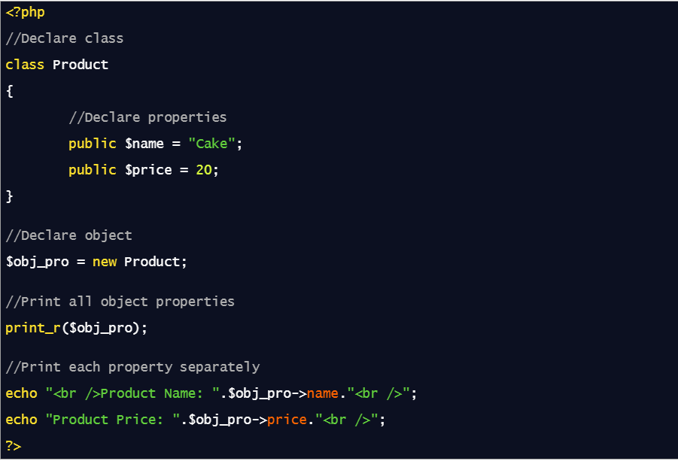
TRY THIS

Slide 8
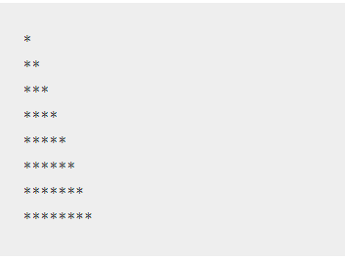
TRY THIS
Write a Program to create following pattern using for loops:
Rules
You can use for or while loop
You can use multiple (nested) loop to draw above pattern

Slide 9
<?php
for($row=1;$row<=8;$row++)
{
for ($star=1;$star<=$row;$star++)
{
echo "*";
}
echo "<br>";
}
?>

Slide 10
TRY THIS
Write a PHP script to calculate and display average temperature, five lowest and highest temperatures.
Recorded temperatures : 78, 60, 62, 68, 71, 68, 73, 85, 66, 64, 76, 63, 75, 76, 73, 68, 62, 73, 72, 65, 74, 62, 62, 65, 64, 68, 73, 75, 79, 73

Slide 11
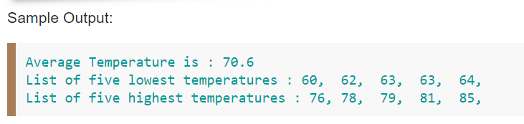
<?php
$month_temp = "78, 60, 62, 68, 71, 68, 73, 85, 66, 64, 76, 63, 81, 76, 73, 68, 72, 73, 75, 65, 74, 63, 67, 65, 64, 68, 73, 75, 79, 73";
$temp_array = explode(',', $month_temp);
$tot_temp = 0;
$temp_array_length = count($temp_array);
foreach($temp_array as $temp) { $tot_temp += $temp; }
$avg_high_temp = $tot_temp/$temp_array_length;
echo "Average Temperature is : ".$avg_high_temp." ";
sort($temp_array);
echo " List of five lowest temperatures :";
for ($i=0; $i< 5; $i++) {
echo $temp_array[$i].", ";
}
echo "List of five highest temperatures :";
for ($i=($temp_array_length-5);
$i< ($temp_array_length); $i++)
{
echo $temp_array[$i].", ";
}
?>

Slide 12
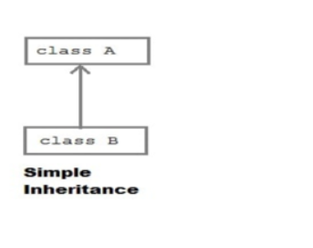
TRY THIS
Write a code for Implementing the following Diagram

Slide 13
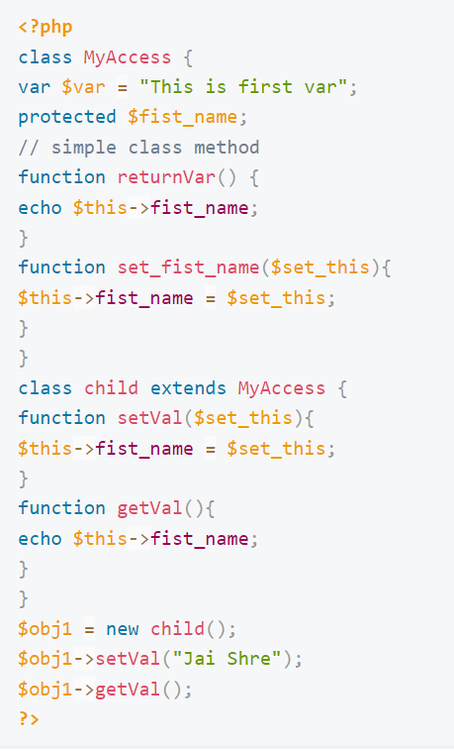

Slide 14
TRY THIS
Write a program to show day of the week (for example: Monday) based on numbers using switch/case statements.
Conditions:
You can pass 1 to 7 number in switch
Day 1 will be considered as Monday
If number is not between 1 to 7, show invalid number in default

Slide 15
<?php
$day = "5";
switch ($day)
{
case "1":
echo "It is Monday!";
break;
case "2":
echo "It is today!";
break; case "3":
echo "It is Wednesday!";
break; case "4":
echo "It is Thursday!";
break; case "5":
echo "It is Friday!";
break; case "6":
echo "It is Saturday!";
break; case "7":
echo "It is Sunday!";
break;
default:
echo "Invalid number!";
} ?>

Slide 16
TRY THIS
Write a PHP program to check if a person is eligible to vote or not.
Condition
Minimum age required for vote is 18.
You can use PHP Functions.

Slide 17
<?php
function check_vote() //function has been declared
{
$name = "Rakesh";
$age = 19;
if ($age >= 18)
{
echo $name . ", you Are Eligible For Vote";
}
Else
{
echo $name . ", you are not eligible for vote. ";
}
}
check_vote(); //function has been called
?>

Slide 18
TRY THIS
Write a PHP program to calculate area of rectangle by using PHP Function.
Condition
You must use a PHP Function.
There should be two arguments i.e. length & width.

Slide 19
<?php
function rect_area($length = 2, $width = 4) //function has declared
{
$area = $length * $width;
echo "Area Of Rectangle with length " . $length . " & width " . $width . " is " . $area ;
}
rect_area(); // function has been called.
?>
Area Of Rectangle with length 2 & width 4 is 8 .

Slide 20
TRY THIS
Write a PHP program using nested for loop that creates a chess board.
Conditions:
You can use html table having width=”400px” and take “30px” as cell height and width for check boxes.

Slide 21

<table width="400px" cellspacing="0px" cellpadding="0px" border="1px">
<?php
for($row=1;$row<=8;$row++)
{
echo "<tr>";
for($column=1;$column<=8;$column++)
{
$total=$row+$column;
if($total%2==0)
{
echo "<td height=35px width=30px bgcolor=#FFFFFF></td>";
}
else
{
echo "<td height=35px width=30px bgcolor=#000000></td>";
}
}
echo "</tr>";
}
?>
</table>

